Slide 1
MALICIOUS URL DETECTOR
BY : GROUP 6

Slide 2




TEAM MEMBERS
Dipika Sangwan
20BCY10010
Yogendra Bijapur
20BCY10065
Parth Agrawal
20BCY10039
Niranjan Surya Prasad R P
20BCY10129

Slide 3

INTRODUCTION
The increasing use of the internet increases the scope for cybercrimes activities, Malicious or malware websites become one of the major threats to cyber security. Malicious URLs host content abnormalities, such as spamming, phishing attacks, exploiting users, threats, etc.
Most of the attackers perform cyberattacks on the Web using malware URLs (since URLs are widely used all over the internet). So, a significant approach is required to detect malicious URLs and identify their attacks in order to protect the user’s data.

Slide 4

EXISTING SOLUTION
Black-List
Black-List is a collection of data of malicious URLs which are previously known. A database lookup is performed every time the system comes across a new URL.
Heuristic classification
It is an improvement to the Black-Listing. Here the signatures are matched and tested to find the relation between the new URL and the signature of the existing malicious URL

Slide 5

LIMITATIONS
Problem 1
Black-List database should be updated as it is not dynamic.
Problem 2
This technique is repetitive, time consuming, and difficult because of newly arising malicious URLs.
Problem 3
Blacklisting cannot detect the suspicious URLs which are not on the list so this method is not effective.

Slide 6

PROPOSED WORK
We have created a website that helps the user to get to know about the URL. On the website, the user can also get to know about the risk score and all other details
The methodology which we are using here in the implementation of this is API scanner which sends the result or found data in a JSON format.

Slide 7

NOVELTY
Reason 1
Our detector is easy to use and very reliable.
Reason 2
It is safe to use since it does not store any
data.
Reason 3
It has high rate of accuracy for the detection
of malicious URLs.

Slide 8



REAL TIME USAGE
How it will aware the audience using it.
This website helps every user to be aware of Phishing and malicious URLs.
Helps the user to protect the data.
Once when the user entered the suspected URL in the app, It scans and shows the results.

Slide 9
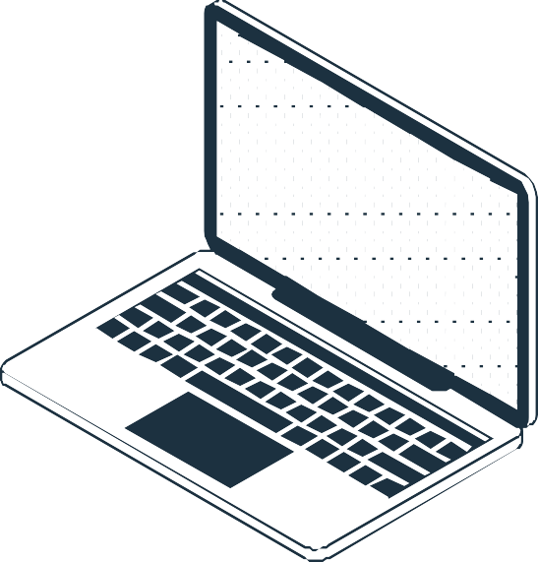

HARDWARE USED
Laptop
SOFTWARE USED
VS Code

Slide 10
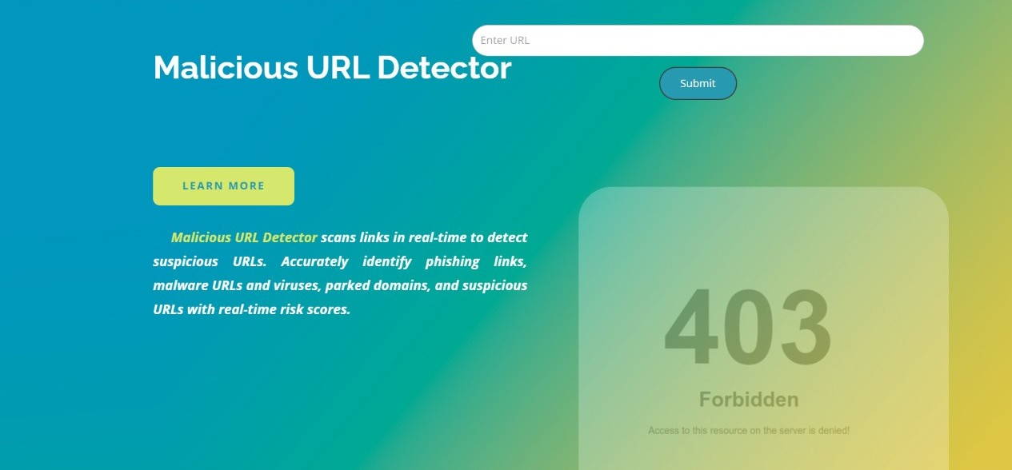
ARCHITECTURE

Slide 11
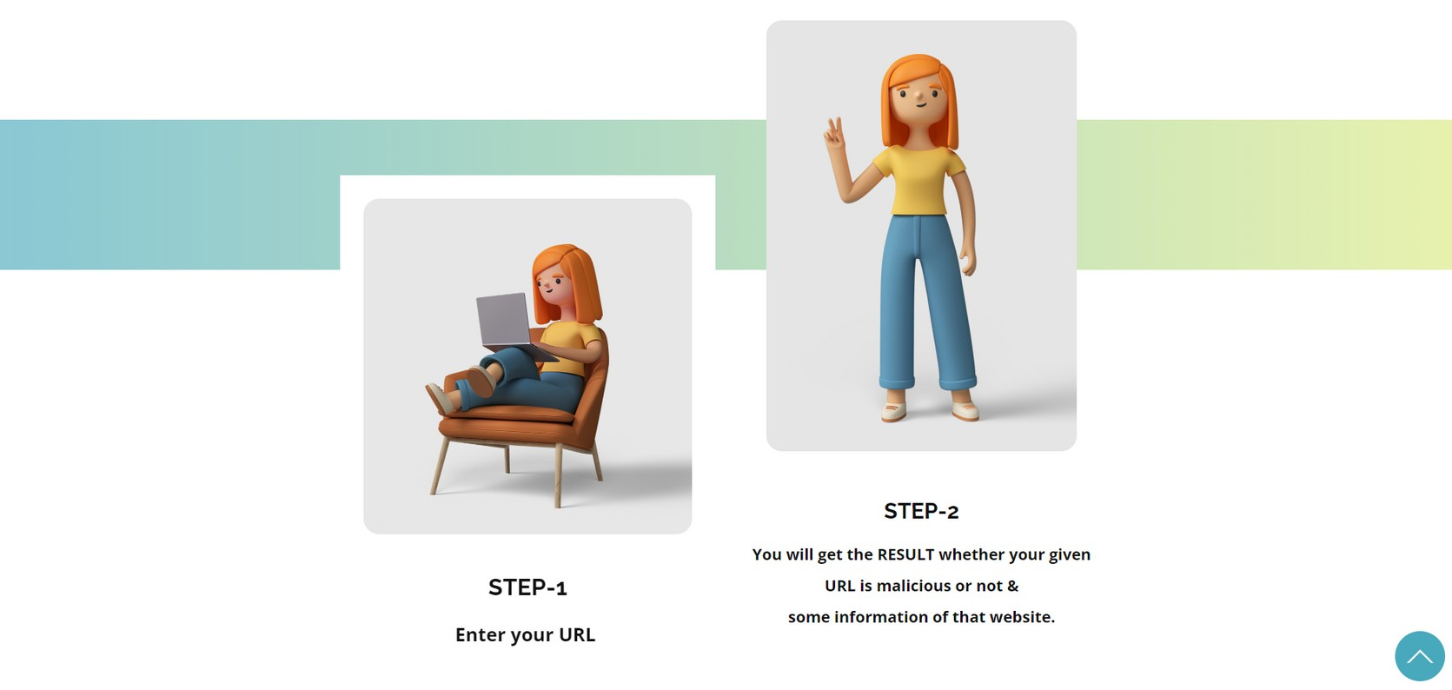
ARCHITECTURE

Slide 12
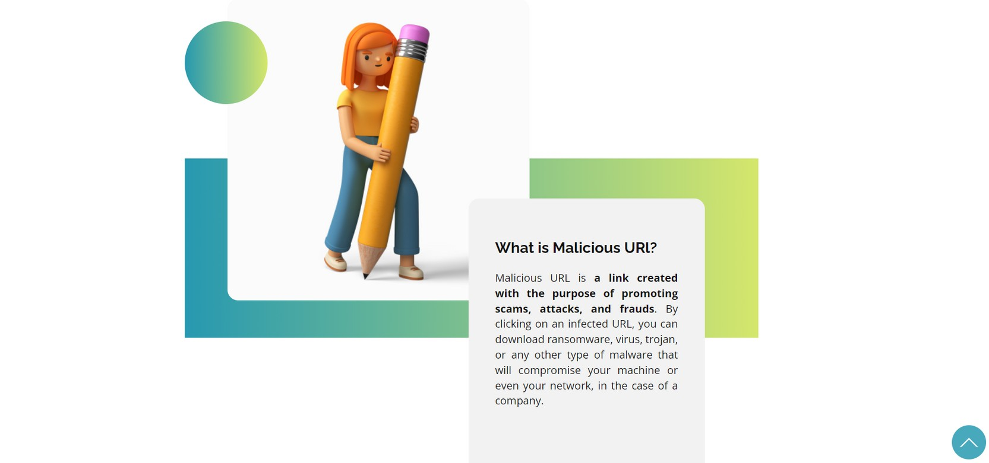
ARCHITECTURE

Slide 13
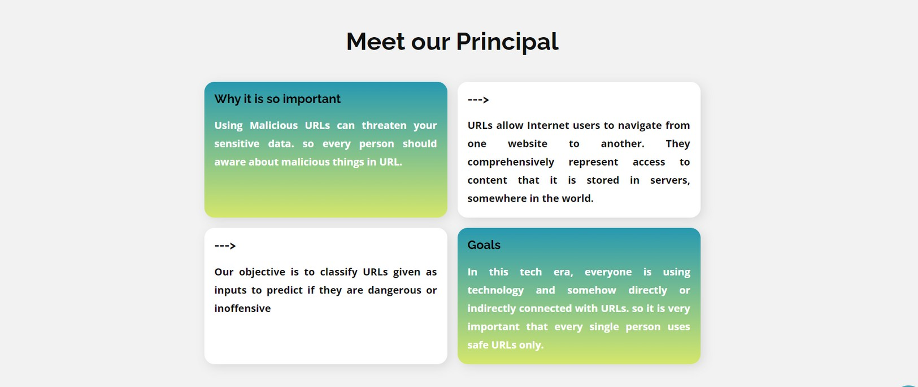
ARCHITECTURE

Slide 14

LITERATURE
While there are a variety of features that one can use to classify if a webpage is spam, this project aims to use only the URL and limited metadatainformation to classify if web pages are spam/not spam.
This choice wasmade for performance reasons, as scraping HTML from web pages isresource-intensive and not useful since the page must have already beencrawled. In the context of a search engine, it is often advantageous to beable to detect if a given URL is malicious before a page is crawled. Thisway, URLs that are likely to be malicious can be deprioritized duringcrawling, and those resources can be used to crawl more useful pages thatare less likely to be malicious.

Slide 15

MODULE DESCRIPTION
Website
The user needs to enter the url, our website will fetch the risk score of url by using API.
API
Application Programming Interface, which is a software intermediary that allows two applications to talk to each other.

Slide 16

MODULE WORK FLOW
Enter the URL
Refer's the API
Fetch Details

Slide 17
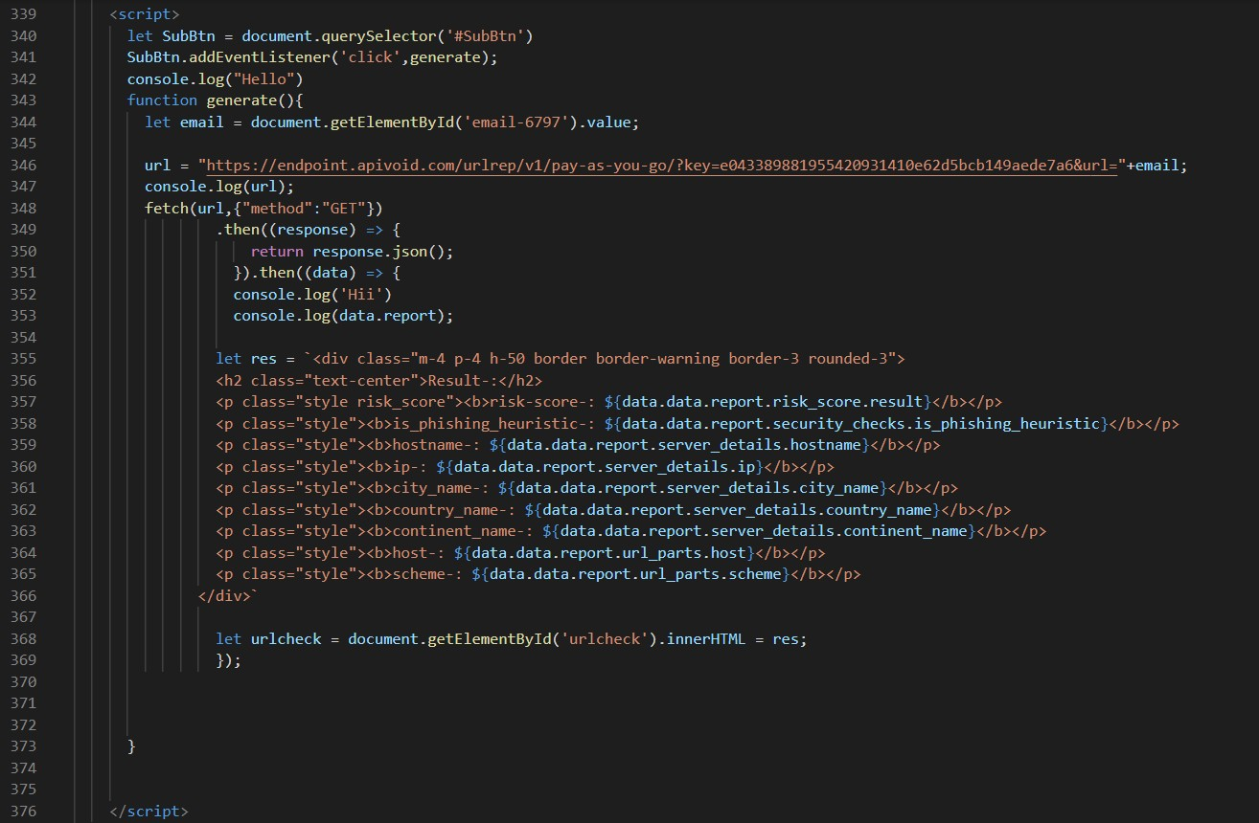
FETCHING API

Slide 18
DEMO:

Slide 19
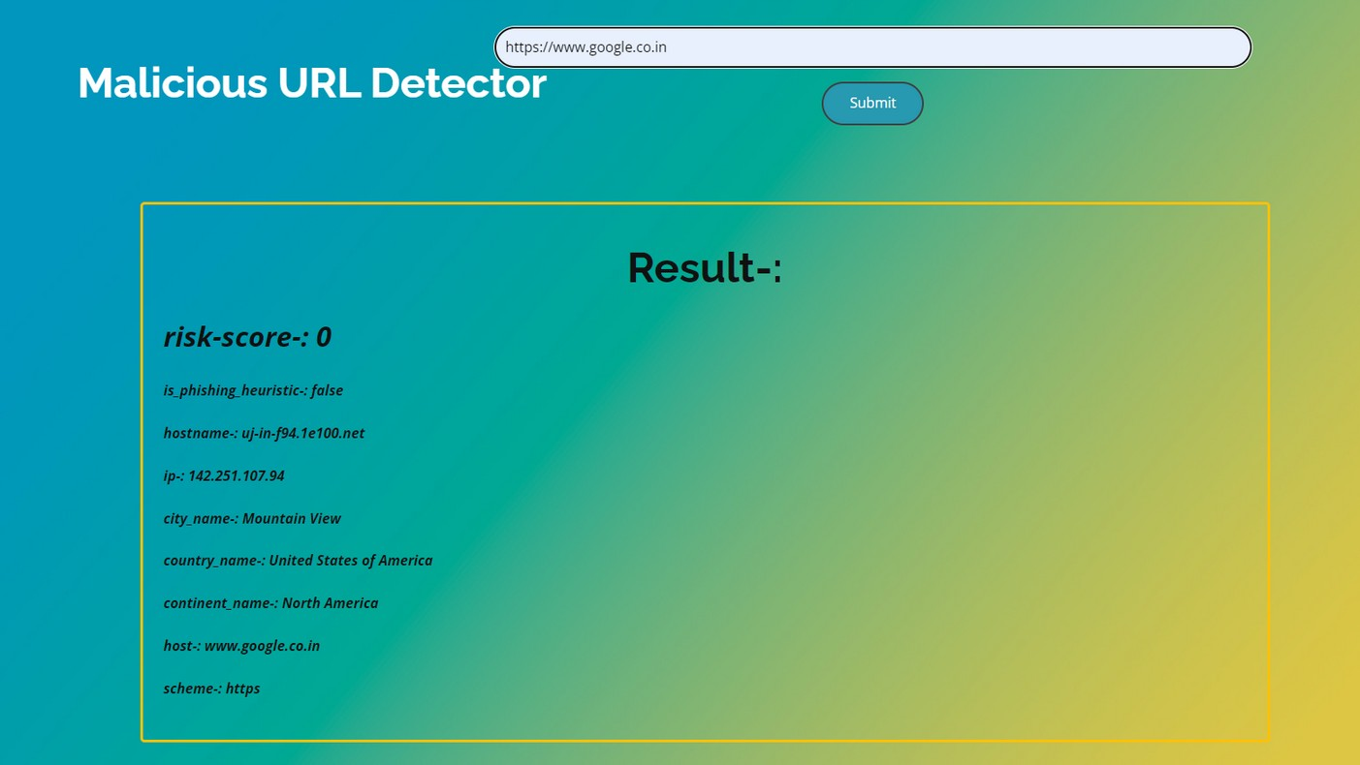
RESULT AND DISCUSSION.

Slide 20
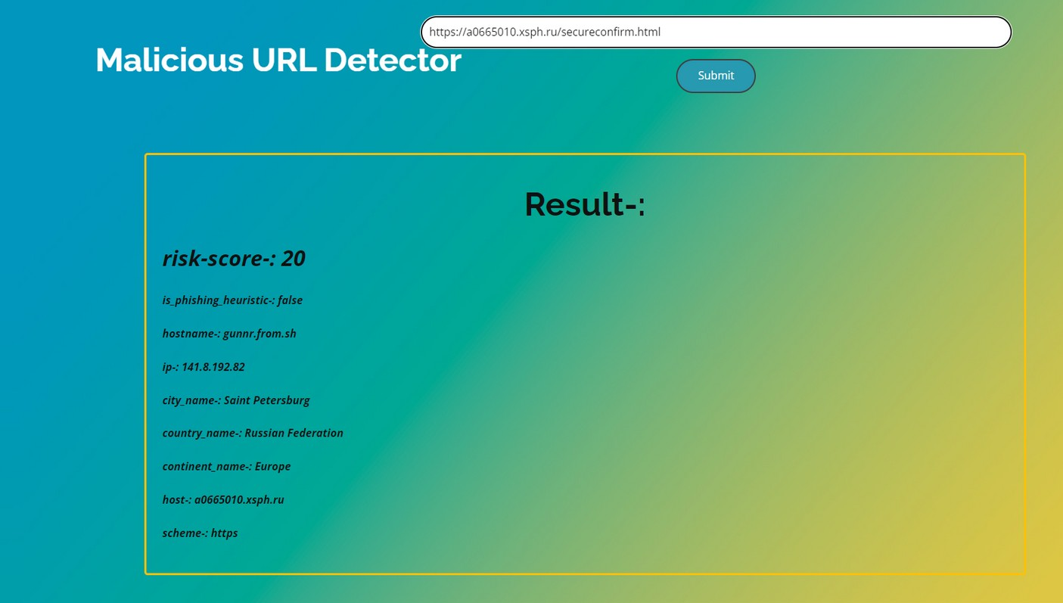
RESULT AND DISCUSSION.

Slide 21


CONCLUSION
The importance to safeguard online users from becoming victims of online fraud, and phishing detection tools play a vital role in ensuring a secure online experience for users. Unfortunately, many of the existing phishing detection tools, especially those that depend on an existing blacklist, suffer limitations
such as low detection accuracy and high false alarm. The inconsistent nature of attacks behaviors and continuously changing URL phish patterns require timely updating of the model.

Slide 22

THANK YOU!

